Slide 1
College Work Readiness Assessment
A Program Evaluation
Brief to the Board on 2012-13 Administration

Slide 2
The Logic Model Flow
CWRA
Assumptions
Inputs
Activities
Outputs
Outcomes
Impact

Slide 3
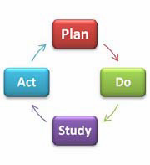
Continuous Improvement
The Framework for Quality Learning
has been in place for nearly a decade.
Curriculum, Assessment, and Instruction Institute (CAI) has focused on Curricula in the past.
In most recent years, CAI learning and vertical teamwork have focused on balancing our assessment philosophy & practices with performance tasks.

Slide 4
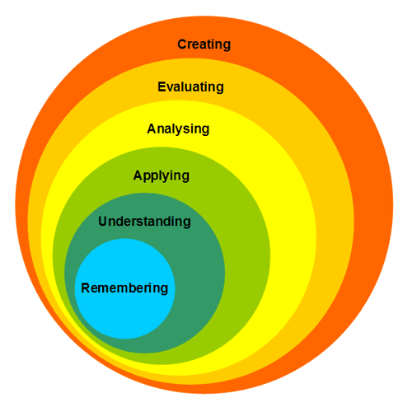
Continuous Improvement
Our teachers and coaches are developing division level performance tasks related to content.
How do we take an externally valid and reliable snapshot of our students’ learning that goes beyond remembering and understanding?
New Bloom's Taxonomy

Slide 5
Continuous Improvement
How do we catalyze the teaching and learning process to produce results that lead to college, workforce, and citizenship readiness?
How do we weigh the value our high school programs add with a scale that matters?
How do we do this work without replicating the SOL testing program?

Slide 6

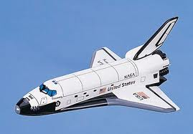
All students will graduate having actively mastered the lifelong-learning skills they need to succeed as 21st century learners, workers, and citizens.
CWRA: sampling 9th and 12th Graders Every Three Years. Institutional Focus
PSAT: all 10th and 11th Graders. Student Focus. AP Exams. Institutional & Student Focus MAP testing with middle school students. Student & Institutional Focus
SOL Testing Program: all students 3-11, every year, with End of Course Testing for High School Students. MAP testing with middle school students. Student & Institutional Focus

Slide 7
College Work Readiness Assessment
(CWRA)
An assessment that tests high school students on their 21st century skills of critical thinking, analytic reasoning, problem solving, and written communication.
Skills that are necessary in work and college environments in the 21st century.
Tests are completed online in a proctor format and are suggested for freshmen and seniors in high school.

Slide 8
CWRA Background
Council for Aid to Education
Description, Participation, and FAQ
Teaching to a Test Worth Teaching To
Assessing Critical Thinking, Analytical Reasoning, Problem-Solving and Writing in High School
Sample Report

Slide 9
Project Timeline
Phase | Time
K-12 Principal Awareness | Spring 2011
Cross-Curricular Vertical Team Training | Fall 2011
ACPS Senior Pilot Assessment | Spring 2012
Results Reported | Late Summer 2012
ACPS High School Assessment: 9th Graders | Fall 2012
ACPS High School Assessment: 12th Graders | Spring 2013
Results Reported | Late Summer 2013
Results Studied | Fall 2013
Action Steps Planned | Fall & Spring 2013 – 14
School and Department Improvement Planning & Doing | 2014 – 2016
Repeat the Assessment Cycle 9th and 12th Graders | 2015 - 2016

Slide 10
Plan for 2012-13
Grade Level | Testing Period
335 9th Graders (100 from each comprehensive high school & full Murray Class) | Fall 2012
325 12th Graders (100 from each comprehensive high school & full Murray Class) | Spring 2013

Slide 11
Plan for 2012-13
We will look for a combination random / stratified sample to include enrollment groups. Entering Academic Ability and the Scholastic Level Exam offer control.
The test takes 1.5 hours. We are targeting dates outside of other testing windows.
Small groups of participants allow for non-instructional personnel (coaches & central office staff) to proctor.
The test is a turnkey operation.

Slide 12
CWRA Reports for 2012-13
Three perspectives are offered & all three of these perspectives are based on national comparisons on a leveled playing field.
College Readiness: our seniors / national college freshmen
Comparison of high school seniors across participating CWRA schools
Effect Sizes: our institutional value-added vs. national sample value added

Slide 13
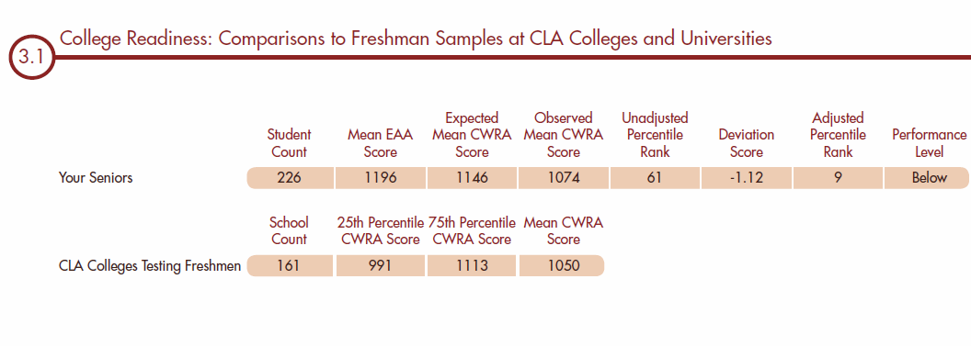

Slide 14
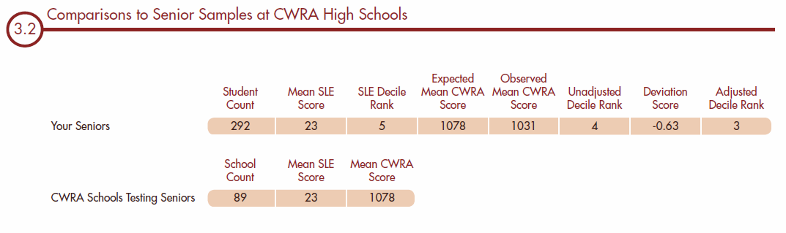

Slide 15
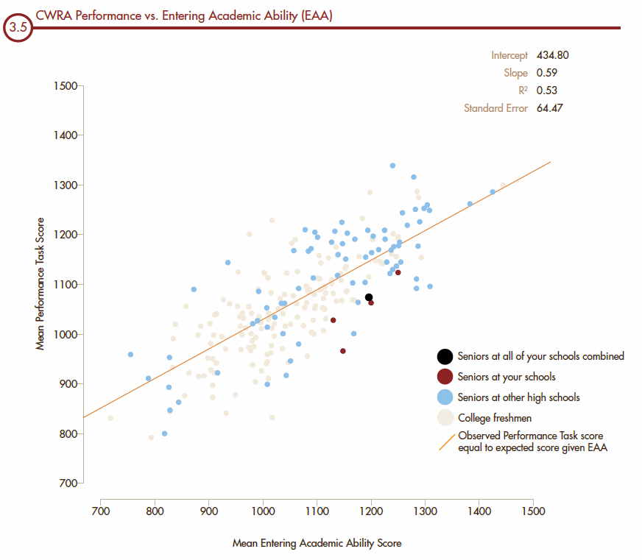

Slide 16
Effect Size / Value Added
An effect size is an expression of the ratio of score variance in the treatment group to chance score variance within the control group.
In this case, the “treatment” is a high school 4-year program.
Treatment Group / Control Group

Slide 17
Effect Size / Value Added
Senior Mean Score – Freshmen Mean Score
______________________________________
Standard Deviation for Freshmen
The result is expressed in standard deviation units.

Slide 18
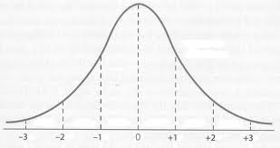
Effect Size / Value Added
34% Value Added

Slide 19
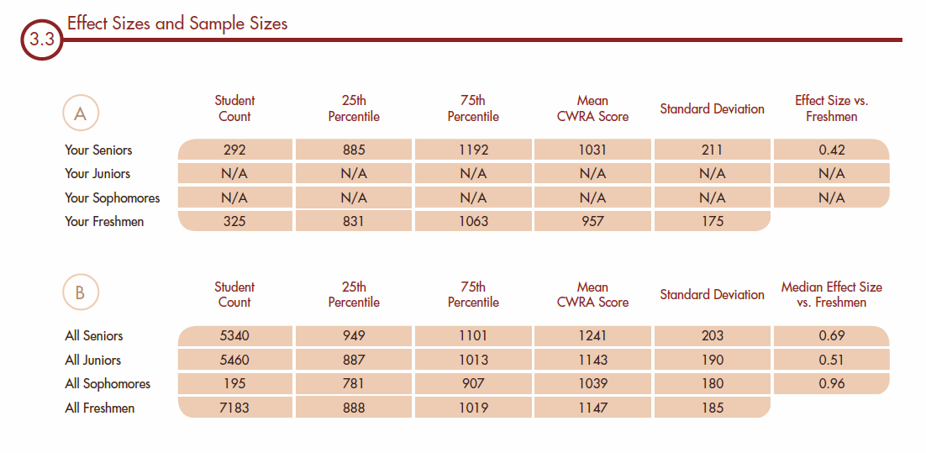

Slide 20
Effect Size / Value Added
34% Value Added
14% Value Added

Slide 21
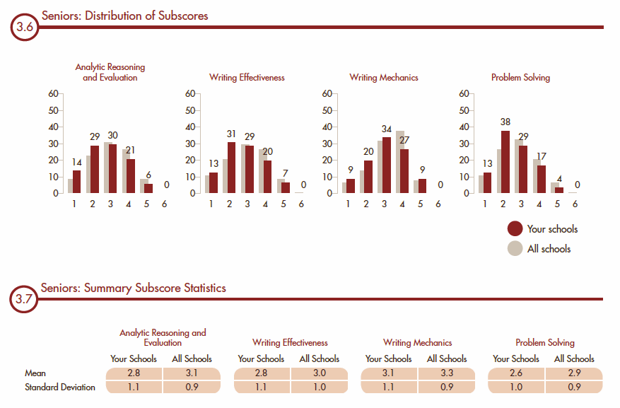

Slide 22
Outputs & Outcome
The outputs of the testing year will include all the reports seen here plus student data for analysis. This should be a data mine to harvest for insights.
Outcomes will result from each school and division-wide study of our reports, using the PDSA Study Questions: PDSA Wheel
We will analyze the data for gaps between our current and desired states and develop school improvement and departmental goals and plans to address these gaps for re-assessment in 2015 – 16.

Slide 23
All students will graduate having actively mastered the lifelong-learning skills they need to succeed as 21st century learners, workers, and citizens.
CWRA
Brief to the Board on 2012-13 Administration

